Slide 1
深度學習系統與實現 LAB4-2 Auto Compression
Dept. of Computer Science and
Information Engineering
National Chiao Tung University

Slide 2
Outline
Overview
LAB 4-2
Grading
Report Spec
Notes:
1

Slide 3
Overview
Traditional pruning trilogy(DSD)
Training
Pruning
Retraining
The target is automate S in DSD
Tune hyper-parameters on validation set.

Slide 4
Overview
In previous lab, using the babysitting
In this lab, we need automatic do pruning
Training
Pruning
Retraining
Pruning
Retraining
Training*
Pruning
Retraining*
Training*
Pruning
Retraining*
Training*
Pruning
Retraining*
Using a pretrained model or not is all up to you
For further, you can automate training process

Slide 5
Overview
HyperOpt provides variable search algorithms
pip3 install hyperopt
http://hyperopt.github.io/hyperopt/
Template code:
https://github.com/chenys1995/distiller/blob/dlsr_lab4_2/examples/lab4_2/one_shot.py
Set objective function by yourself
Recommend using git to backup
Bitbucket provides free private repository

Slide 6
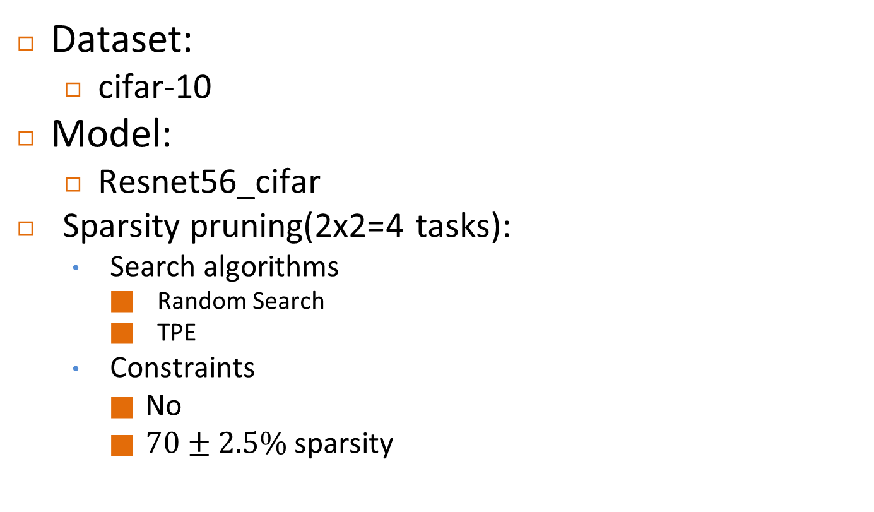
LAB4-2 Experiment 70%

Slide 7
LAB 4-2 Q&A(30%)
Explain how you deal with constraints
Search space
Objective function
Compare with different algorithms
Draw and explain the Pareto curve
Give a global constraint
Can hyper-parameters optimization easily fit constraints?
Can human-design space easily cover all possibility?
How do we avoid curse of dimensionality with the increase of the number of layers?

Slide 8
Grading
LAB 4-2 Experiment (4*17.5%)
LAB 4-2 Question(5*6%)
Submission to E3:
Source code
Report
log files(optional)
zip format (ex: dllab_lab4_2_{group id}.zip )
Deadline : 2018/11/12 23:59:59
Total: 100
Notes:
1

Slide 9
Report
Introduction
Experiment setup
Result
Conclusion
Anything you want to say

Slide 10
Reference
Multi-Objective Optimization
https://engineering.purdue.edu/~sudhoff/ee630/Lecture09.pdf
DSD: Dense-Sparse-Dense Training for Deep Neural Networks
https://arxiv.org/abs/1607.04381

